Slide 1
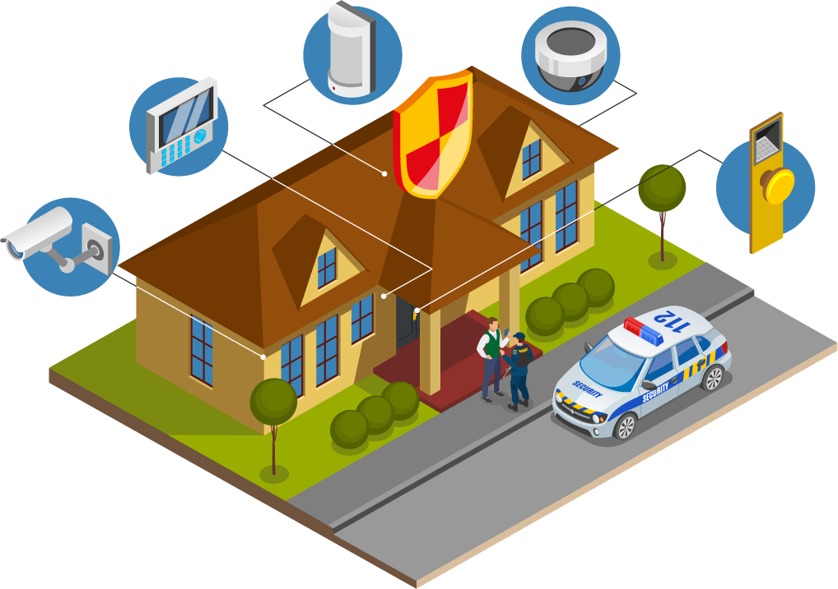

System Analysis And Design
Residential Security
Monitoring System
Presentation
UNIVERSITY OF ASIA PACIFIC
Department Of CSE
Course Code: 306

Slide 2
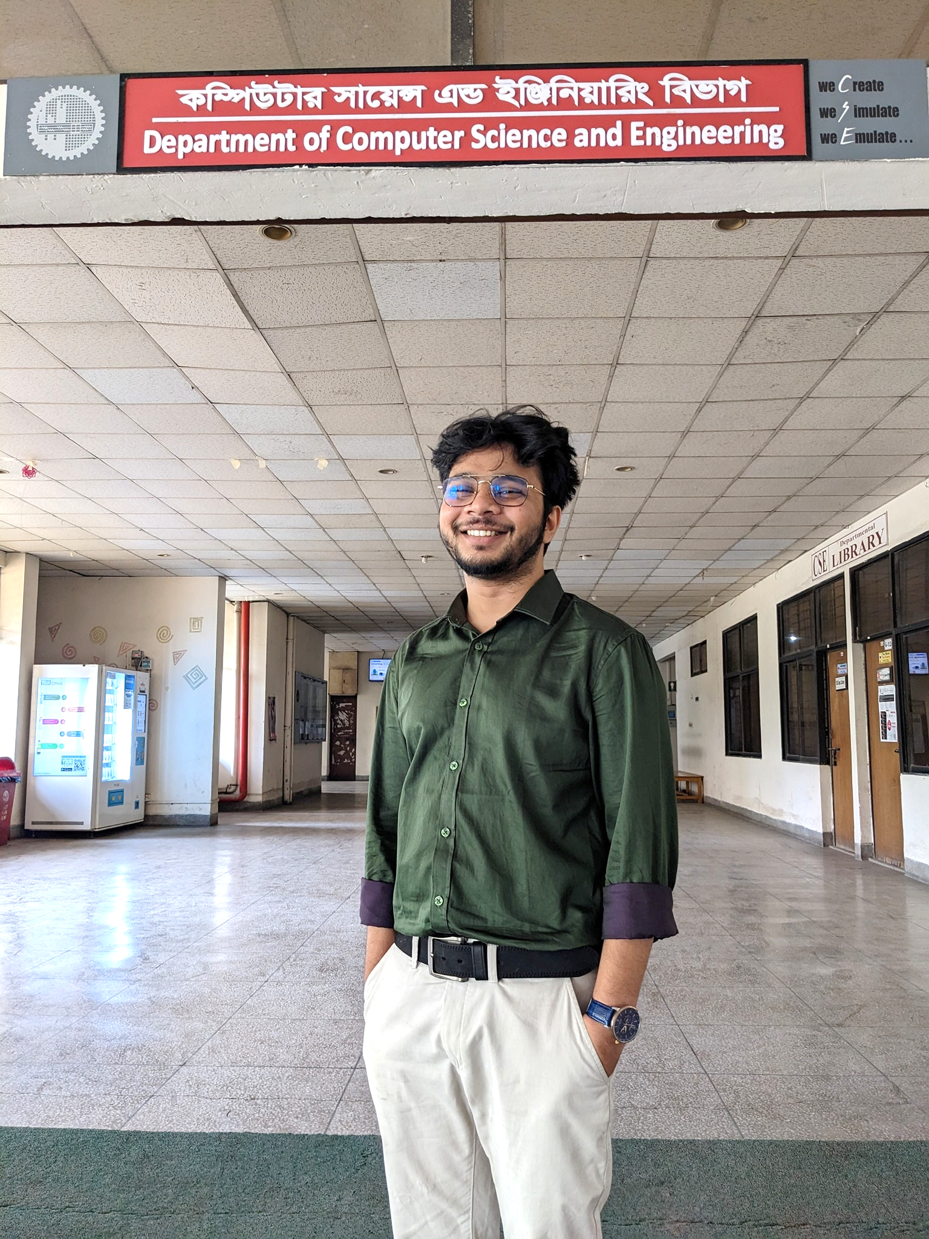
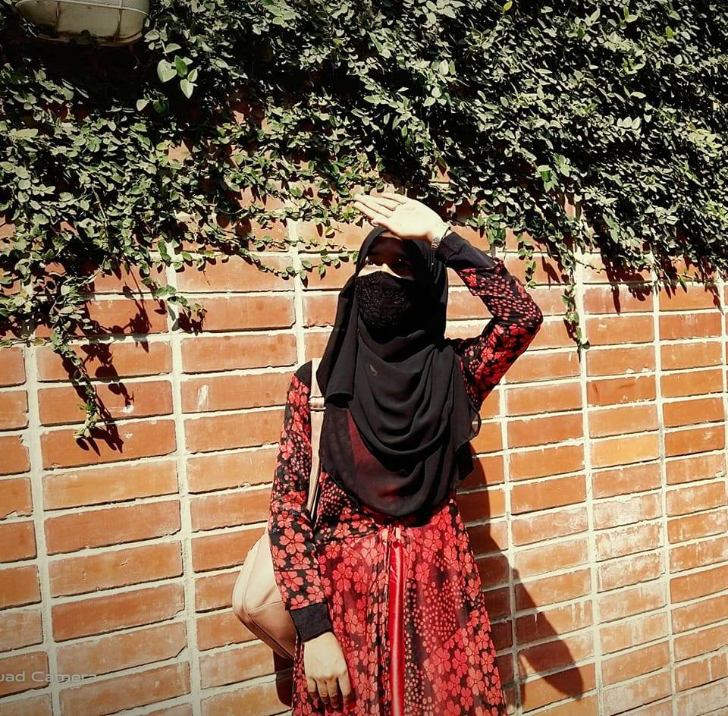

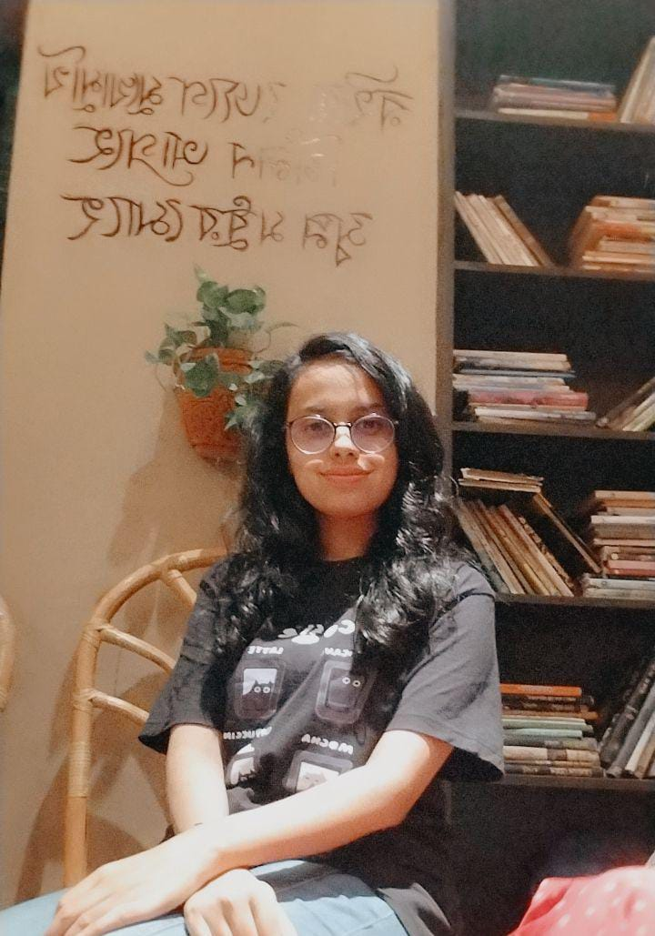

Instructor
Muhtasim Noor Alif
Team Members
Maria Akter Khushi
21201107
Ritu Rani Banik
21201108
Jannatul Ferdousi
21201114
Nur Habibah Binte Mahbub
21201103

Slide 3
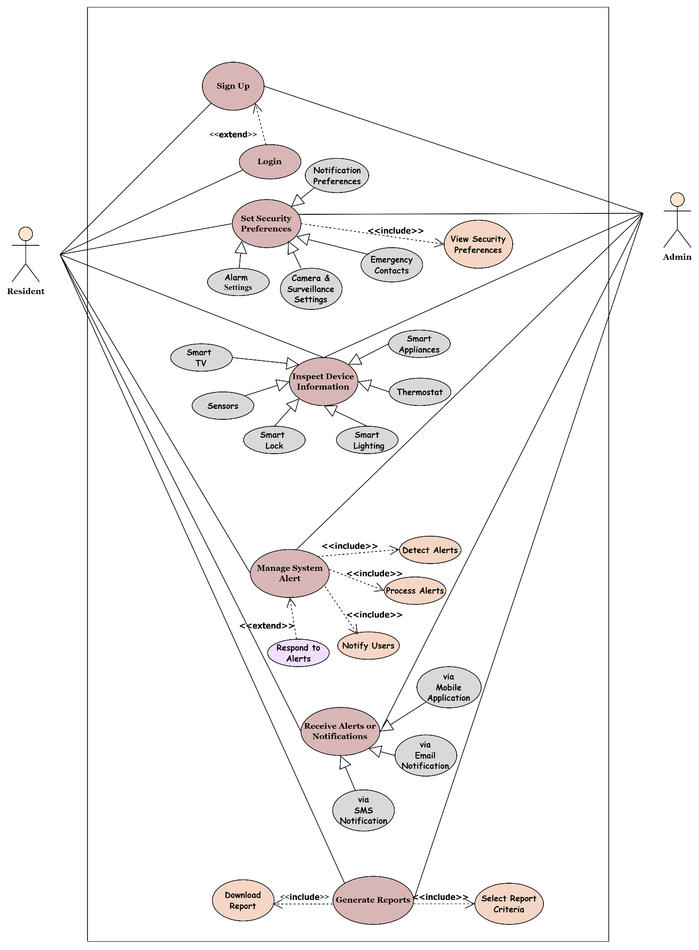
Use Case
Diagram:

Slide 4
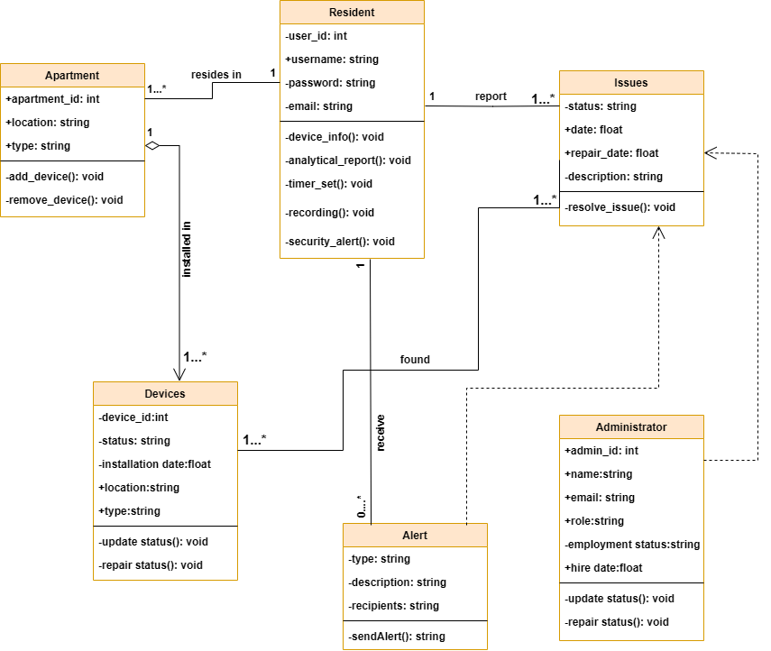
Class Diagram:

Slide 5


